Slide 1

Graph Representation Learning and Reinforcement Learning for Drug Discovery
Solving COVID: the Engineers’ way
Group 14
Final project: MIE 1517
Winter 2022

Slide 2

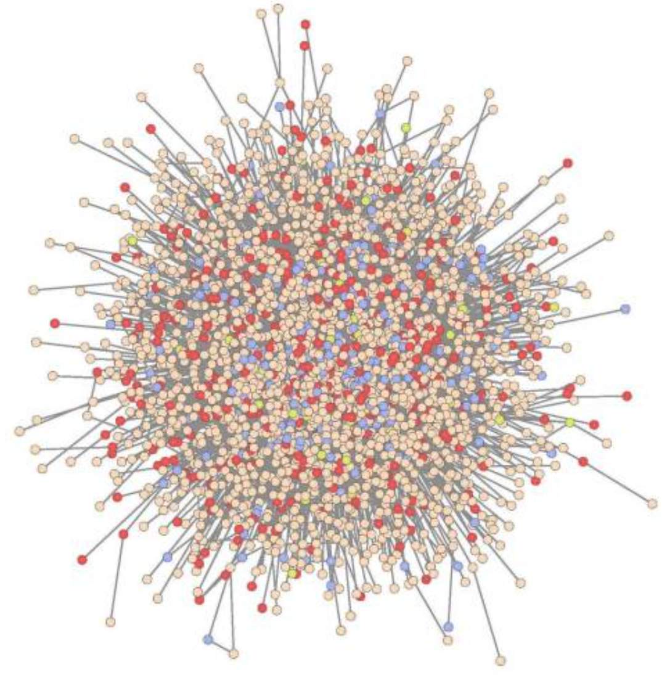
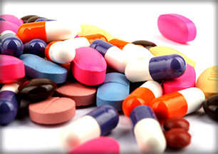
Background
Notes:
Biological networks have a key role in drug discovery for disease treatment.
The study of biological networks and identifying critical nodes can facilitate identification of the key targets in treating diseases.However, efficiently finding critical nodes with low cost is challenging. Additionally different experimental works exist to identify critical nodes which are expensive and time consuming (moved to next slide)

Slide 3
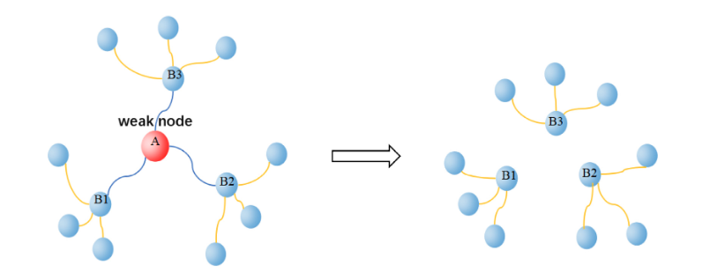
Step 2: Network Dismantling (ND)
(Wang et al, 2020)
Notes:
Then we can apply a technique called Network Dismantling, which allow us to find a minimum cardinality set of proteins whose removal would optimally dismantle the interactions in the protein- protein network and help neutralize harmful organisms such as bacteria or viruses.
Finding key players or nodes in protein-protein interaction networks can have great implications for structure based strategies of drug design.

Slide 4
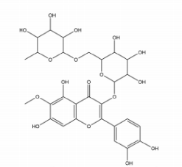
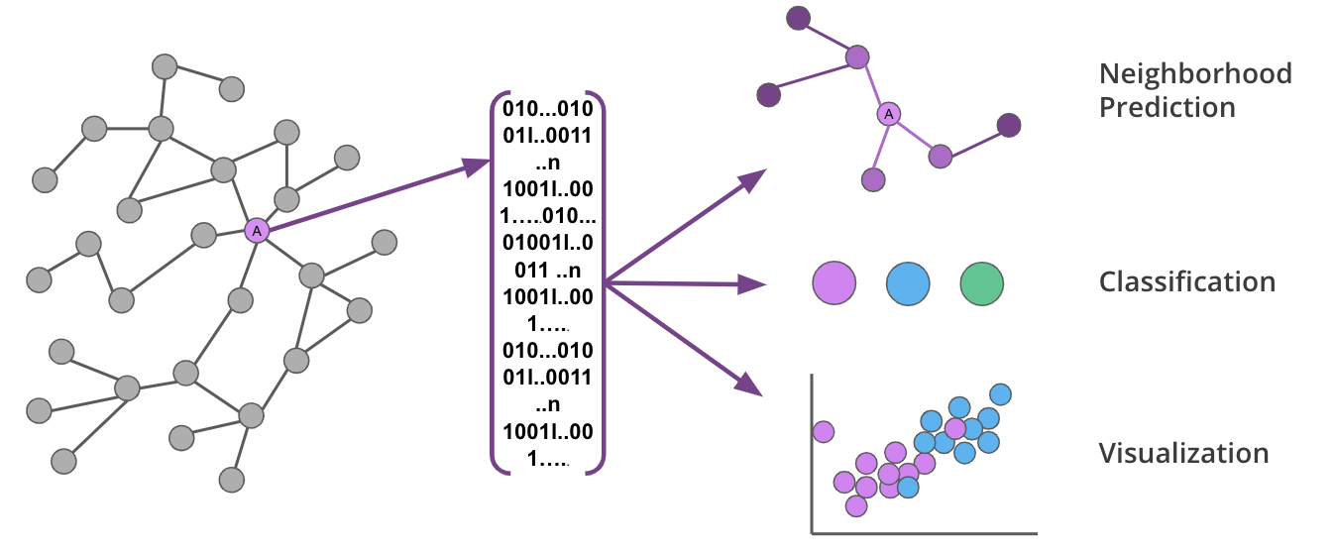
Engineers’ view - Graphs
Notes:
In our engineers’ view, we can abstract those molecules and compounds and turn them into some data structure we familiar with. A natural way would be converting them into graphs.

Slide 5
Critical Node Detection Problem (CNDP) & Network Dismantling (ND)
Classical heuristics
Classical heuristics
Graph partition based methods
Graph partition based methods
Node centrality based method
Node centrality based method
Optimal decycling based methods
Optimal decycling based methods
RatioCut
Generalized Network-Dismantling (GND)
High Degree Adaptive (HDA)
High Betweenness Adaptive (HBA)
High Closeness Adaptive (HCA)
High PageRank Adaptive (HPRA)
MinSum
Belief Propagation-guided Decimation (BPD)
MinSum
Belief Propagation-guided Decimation (BPD)

Slide 6
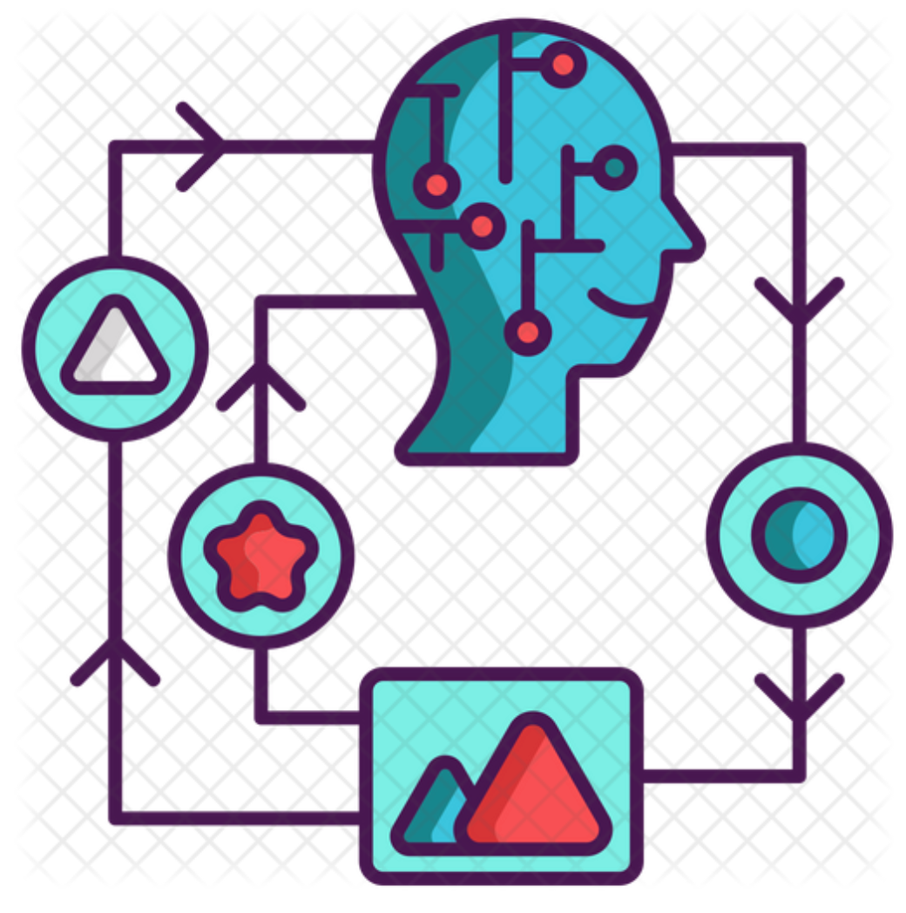
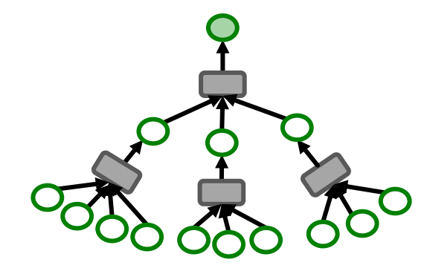
Can we solve it with ML?
Seed model: FINDER ( finding key players in complex networks)
GNN
DQN
Notes:
Recent advances in representation learning on large graphs and deep reinforcement learning can come to rescue.
FINDER: finding key players in complex networks[1]

Slide 7
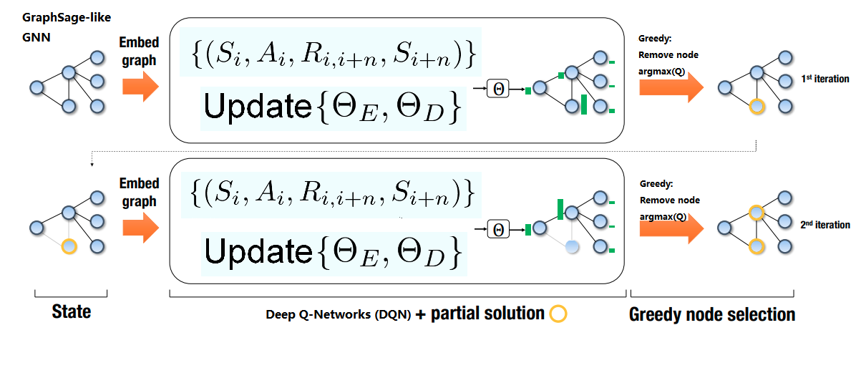
Model - offline training flow
Synthetic graphs: BA for original models, or CM(based on HI-II-14)
Khalil et al, 2017
Notes:
FINDER, an RL-based framework for finding key players in large networks, is composed of three main components: encoder, decoder, and greedy selection modules.
The Encoder is a GNN that follows GraphSAGE architecture[2] and leverages nodes’ two hop neighbourhoods for making their embeddings
The Decoder is a MLP that provides a mapping from the node embeddings to a scalar value approximation. This scalar value for a node signifies the advantage of removing it.
The Greedy selection module selects a subset of nodes based on highest score and remove these solution nodes from the graph.

Slide 8
Model - enhancements
From TensorFlow v1 to pyTorch.
Pytorch-sparse for performant sparse operations
Configuration Model (CM) graphs for fine tuned training.
Different DQN variants (Double DQN v.s. Vanilla DQN)
Notes:
Motivation:
Training with only synthetic graphs is good for generalization, but can we leverage the knowledge that our testset will be protein-to-protein networks?
Configuration Model:
Generate synthetic graphs, with degree distributions w.r.t samples from a certain training set of protein-to-protein networks.
—--
Motivation:
After applying Configuration Model, how do we balance the possible overfitting due to sampling very similar datasets.
Double DQN:
Use a secondary DQN that is the copy of the main DQN from the last episode, this reduces the

Slide 9
Real-world dataset (Testsets)
The Human Reference Protein Interactome Mapping Project
Dataset | Number of interactions | Dataset | Number of interactions
H-I-05 | 2765 | Venkatesan-09 | 196
HI-II-14(CM base) | 13993 | Yang-16 | 729
HuRI | 52569 | Test space screens-19 | 1159
HI-union | 64006 | Yu-11 | 1190
HI-union-exclude-14 | 10056 | Lit-BM | 13441
(http://www.interactome-atlas.org/)
Notes:
For the left ones starting with H and HI, we call them the HuRI family. They are the original sets conducted from the project.
While HI-I-05 represents ~12% of the complete search space, HI-II-14 covers ~42% of the search space, and HuRI covers ~77% of the complete search space.
The right side ones are datasets conducted from different screening methods, for example Y2H screening, which stands for yeast two-hybrid screening.
At last, HI-union is an aggregate of all PPIs identified in HI-I-05, HI-II-14, HuRI, Venkatesan-09, Yu-11, Yang-16, and Test space screens-19.

Slide 10
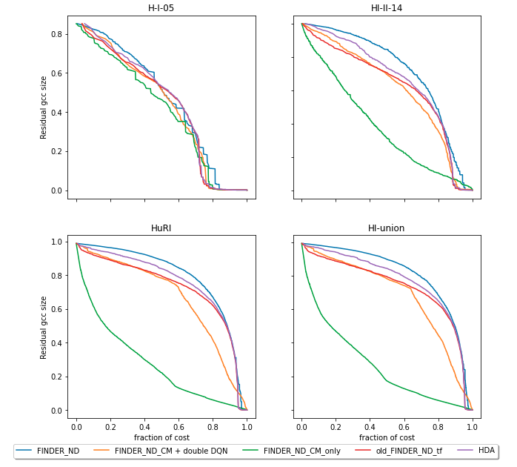
Results
The HuRI family
Notes:
Here we present the ANC curves of the solution generated by our models. The solution is a sequence of node index to remove.
The horizontal axis is the fraction of the removed nodes, and the vertical axis is the relative size of the giant connected component (GCC) of the residual graph.
Old_FINDER_ND_tf is the original FINDER model written in tensorflow.
FINDER_ND is our new model re-written in PyTorch and torch sparse.
FINDER_ND_CM + double DQN is the model patched with configuration model and double DQN.
FINDER_ND_CM_only is the model patched only with configuration model.
We can see that our CM_only model outperforms the state-of-the-art model FINDER, and the heuristic benchmark HDA with a significant amount on the HuRI family datasets.

Slide 11
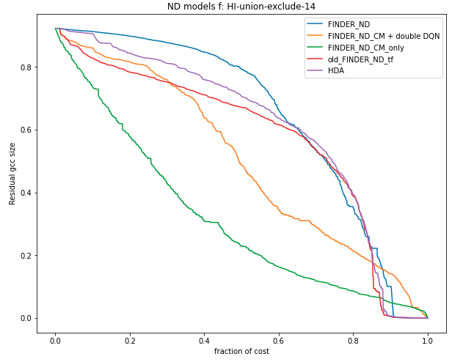
Results
Strictly-new dataset
Notes:
But wait, since we used HI-II-14 as our based for configuration model, which means we actually took a look at the degrees of the testset graphs don’t we? Maybe that’s why we have such a good performance on the HuRI family.
Besides, we know that there are some overlapping proteins within the HuRI family.
Now, in order to show that our model works on completely new datasets, we construct a new testset, by exclude proteins within HI-II-14 from the biggest HI-union dataset. So the new dataset will be strictly unseen by our model.
As you can see our model still presents a good performance on this testset.

Slide 12
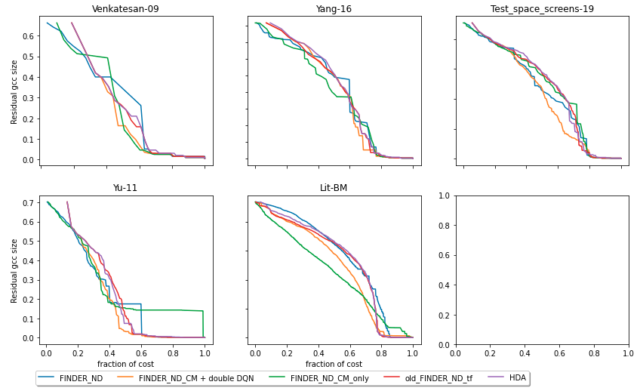
Results
Other
datasets
Notes:
As you can see our model can also generalize to other datasets, achieving similar or slightly better performance comparing to original FINDER and HDA.

Slide 13
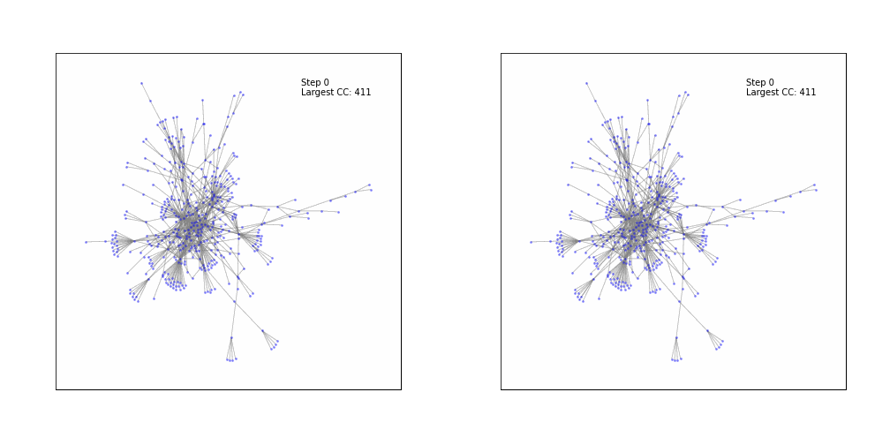
Results - visualization
FINDER_ND_CM
HDA

Slide 14
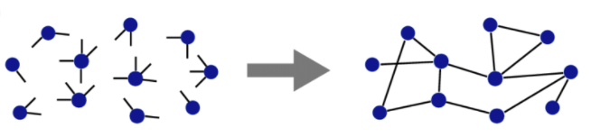
Takeaways - graph neural network
Configuration model is a very powerful tool.
But do look out if your problem is sensitive to overfitting.
Notes:
Thanks Masroor.
As you can see from our results, configuration model is a very powerful tool if your application is not sensitive to overfitting.
In our case, since the goal is to solve CNDP on the protein networks, and we know that CNDP is an NP-hard problem. “Overfit” our model to the HuRI family is actually an acceptable approach. Next slide plz.

Slide 15
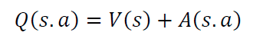
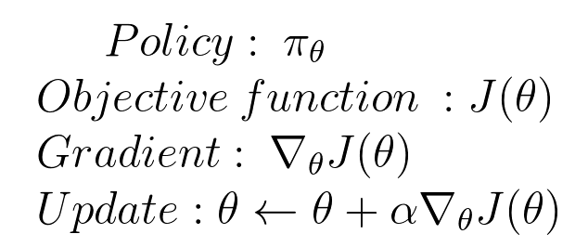
Takeaways - reinforcement learning
Dueling-DQN
Policy gradient methods
Notes:
Now for anyone who wants to try a similar structure, in terms of the reinforcement learning part.
Dueling-DQN is another RL method worth trying. Dueling-DQN breaks the q_value into state values and Advantage values of doing action a while in state s. We believe this will help generalize learning across actions.
We also recommend trying policy gradient methods, which is essentially using a Neural Network to approximate mapping from state space to policy itself. Next slide plz.

Slide 16

Takeaways - environment setup
Colab is able to reproduce the environment, but needs to rebuild the env everytime. You can actually run git cmds within the Colab VM.
Docker is a good option, you can package your environment with dockerfiles. However, make sure you have a modern OS.
Best on training speed: offline GPU workstation.
Notes:
Since our model has so many libraries and dependencies, one of the challenges we had was to set up the environments for every team member.
The ultimate online solution would be Colab plus github. One major drawback of this setup is that you have to re-build the packages and dependencies every time. In our case, it take about 16 minutes.
If you want to work offline, we recommend docker.
Our final choice was to run our training on an offline laptop with GTX3060, it takes about 10 hours for each complete training.
Next, I will pass it to Faraz.

Slide 17

Takeaways - pytorch V.S. tensorflow
Faster static computation graphs can be compared to eager execution.
Sparse-tensor calculations are very expensive on GPU machines.
The performance bottleneck of sparse operations (especially in Pytorch) is something to keep in mind when embarking on GNN projects.

Slide 18
Summary
In this project, we show that a part of the drug design process can be reduced to a CNDP problem, and we can solve it with machine learning models.
Other than biology, CNDP also has large amount of applications in social science, marketing, and supply chain management.
Notes:
We do find papers about COVID and it’s proteins and molecules, but understand them and match them to the HuRI nodes is beyond our knowledge base.
Yeah, we bragged a little bit about solving it in the beginning. However we hope our state-of-the-art CNDP solver model would help us to parse and solve the structure of COVID virus. Engineers, chemists, doctors, any jobs or knowledge you have, we are on the same side in this contest. Together and united, that’s how us, the human race solves COVID.

